Slide 1
The Strength Behind Our Stories
Year 1
Strategy Report
Notes:
Giorgos

Slide 2
This strategy focuses on ensuring we provide the best care possible for our communities in a challenging and changing healthcare, political and financial environment.
As a society we are getting older and living with more complex conditions.
Having adapted our services through previous strategic plans, we remain committed to increasing our community support to reach those who need us.
Our population continues to rise, coupled with an ageing population, our services will be required more than ever in coming years.
Our focus for the next 3 years will, therefore, be on understanding who our community is, the types of support that best meets their needs and identifying the barriers to accessing this support. We need to attract, retain and develop our workforce to meet these support needs, nurturing talent and cultivating leaders for the future. Finally, as the Hospice approaches its 50th birthday we look to ensuring the sustainability of the Hospice for the future. We will grow diverse charitable income streams while challenging the Scottish Government to provide sustainable funding for the Hospice sector. We will commit to reducing our environmental footprint while harnessing developments in digital technology to embrace new opportunities for communication, care provision and efficient working.
This report outlines the main achievements in year 1 of the strategy, the areas we have been unable to progress and the priorities for years 2 and 3.

Slide 3
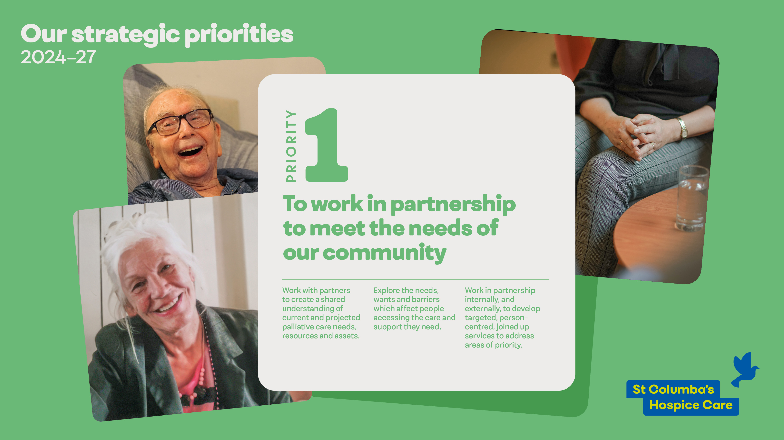

Slide 4
1.1 Work with partners to create a shared understanding of current and projected palliative care needs, resources and assets
Over the period of Year 1 of this strategy we have:
Undertaken a population demographic, socioeconomic and equality data review to better understand who is in our community. We have compiled an internal ‘data report’ to reference this and have identified key resources and tools for ongoing updating of such data moving forward. This offers a clear understanding of who is in our community, creating a foundation from which to engage.
Presented a collaborative update with Marie Curie Edinburgh on the current landscape of Hospice services across Lothian to the Primary Care Local Medical Committee (LMC) subgroup.
Worked with colleagues from NHS Forth Valley and Universities of Strathclyde and Durham to develop a proposal for a literature review on healthcare professionals’ communication at end-of-life.
Co-led an ongoing research study on understanding and assessing arts and health work for people with dementia participating across the UK.
Completed a national mapping of arts service provisions across hospices across Scotland, and of music therapy provisions in hospices across Italy.
Contributed as a site to the POST international multi-centre observational study exploring the use of the term ‘"cancer survivors" and people’s views of it.
Completed Cancer Cachexia Prevalence Study: Retrospective review of 513 cancer related deaths over a 3-year period at St Columba's Hospice Care.
Next steps:
Summarise existing evidence on population trends for, and needs of, unpaid carers in Edinburgh and East Lothian and present this to relevant stakeholder groups to identify priorities for action.
Consider how best to map who the hospice is serving against the local data to better understand gaps, needs and establish a baseline for future work.
Develop our Stepped Care Model for Bereavement and embed this within the Hospice.

Slide 5
1.2 Explore the needs, wants and barriers which affect people accessing the care and support they need
Over the period of Year 1 of this strategy we have:
Developed further our gender diversity group and linked to SPG1’s work on Equality, Diversity and Inclusion (EDI).
Registered scoping literature review on EDI in palliative care.
Designed and piloted an online staff survey about EDI.
Started to review the existing evidence on unpaid carer needs.
Rolled out bereavement charter - Primary Schools awareness.
Collaborated with QMU for establishing the university’s bereavement group which led the bereavement charter within the university.
Completed a service evaluation project regarding our care at home provisions.
Explored through research and education the needs, wants and barriers (including the Palliative Arts No17 Talks).
Developed further the hospice’s public health palliative care framework.
Submitted research grants applications with various partners to explore the needs, wants and barriers which affect people with dementia, and those benefitting from musical care work.
Next steps:
Implementation of EDI survey across hospice staff and volunteers to inform future workstreams.
Consult/engage with stakeholders around our equality, diversity and inclusion (EDI) work; EDI knowledge exchange/world café event.
Analyse gaps in service uptake and proactively seek to better understand with communities the barriers and reasons for this.
Explore how our website can be better used to provide information to carers and bereaved relatives.
Disseminate the hospice’s public health palliative care framework and engage with relevant stakeholders to refine.

Slide 6
1.3 Work in partnership internally, and externally, to develop targeted, person-centred, joined up services to address areas of priority
Over the period of Year 1 of this strategy we have:
Worked with Scottish Government Palliative Care strategy group to further future care planning knowledge and understanding from a whole health, social care and general public perspective.
Developed a Future Care Planning model, resources, and training for the hospice workforce, and for the general public.
Joined the Scottish Chamber Orchestra’s new Music and Dementia Advisory Group to promote targeted and joined up initiatives in Scotland.
Worked with VOCAL to develop a new carer support group.
Liaised with multifaith representatives to improve understanding and accessibility of hospice services.
Provided trauma-informed and trauma-skilled training to all staff to improve access to care and support for people affected by current or historical trauma.
Worked with national and local partners to ensure quality information is available to everyone in simple and easily understood formats.
Led the first Knowledge Exchange event for our University Hospice partnership to promote further links and joined up initiatives (including new placement opportunities to address areas of priority).
Hosted trainees from the NHS Scotland Management Training Scheme 2025 to promote joined up understanding.
Hosted numerous international educational visits.
Next steps:
Offer education and engage in dialogue with key professional stakeholders (e.g. GP training sessions).
Launch a Future Care Planning webpage to offer all resources, guides and video/training for people to access alongside a future care plan for people to populate, in line with the national FCP to be launched.
Organise consultation event for the hospice’s emerging Public Health Palliative Care framework

Slide 7
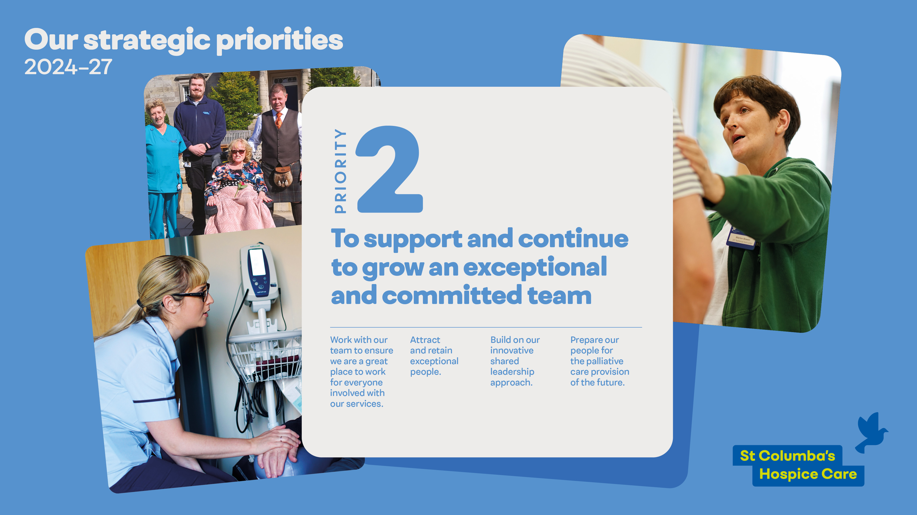

Slide 8
2.1 Work with our team to ensure we are a great place to work for everyone involved with our services
Over the period of Year 1 of this strategy we have:
Worked with our teams to define our team culture through a series of culture workshops and related activities.
Worked with our teams to define 'our behaviours' based on our hospice values.
Created and delivered a week of activities to celebrate world wellbeing week.
Continued to facilitate resilience based clinical supervision across our teams.
Next steps:
To continue to embed our values and team culture by integrating within our recruitment, education and Personal Development Plan process.
To embed 'our behaviours' in our recruitment, onboarding, and team development processes.
To explore potential implementation of 'restorative culture' model across hospice systems, polices and processes to support a psychologically safe culture and experience for our teams.
To develop and implement a new Wellbeing strategy.

Slide 9
2.2 Attract and retain exceptional people
Over the period of Year 1 of this strategy we have:
Participated in an Investors in People review, maintaining our Gold status.
Completed our first assessment towards Investors in Wellbeing, attaining a Silver award.
Co-produced a refreshed personal development plan and review process with our teams.
Next steps:
Meetings with individual teams to celebrate successes from staff survey and to identify areas for shared learning and development.
Implementation of refreshed personal development review process across all teams.
Develop a staff wellbeing framework and associated SharePoint intranet for ease of access.
Create resources including staff experience videos to be used during recruitment.
Further utilise the recruitment package and cascade systems to develop a pathway from recruitment to employment, incorporating leadership and learning development.

Slide 10
2.3 Build on our innovative shared leadership approach
Over the period of Year 1 of this strategy we have:
Created a new leadership development programme in partnership with GoFastForward ready for implementation in early 2026. The programme is a series of short learning modules with both in-person and virtual learning.
Created refreshed induction programme for new leaders.
Next steps:
Development and implementation of a leadership 'playbook' to support or leaders to have the knowledge, skills and confidence to set them up for success.
Delivery of leadership development programme to first group of hospice leaders. Outcomes anticipated to include behaviors aligned with hospice values, confidence in resolving conflict and handling difficult conversations, coaching and feedback capabilities, resource management, leading change and adaptability and decision making.
Implement refreshed induction programme for new leaders
Evaluate impact of the commitments above

Slide 11
2.4 Prepare our people for the palliative care provision of the future
Over the period of Year 1 of this strategy we have:
Extended our Insights sessions to wider hospice teams to support individual and team development.
Supported a scoping exercise of education provision across the hospice establishing what learning and development teams - outwith practice development - are doing.
Next steps:
Continue to integrate Insights-based learning into the leadership training plan, ensuring team leads actively apply these principles to enhance team development and future-ready care delivery.
Develop a comprehensive Palliative Care Learning Framework for all staff, tailored to roles and responsibilities and incorporating our current Learning framework. This will build on insights from the scoping exercise, feedback from mandatory training, SCHC priorities and best practice standards.

Slide 12
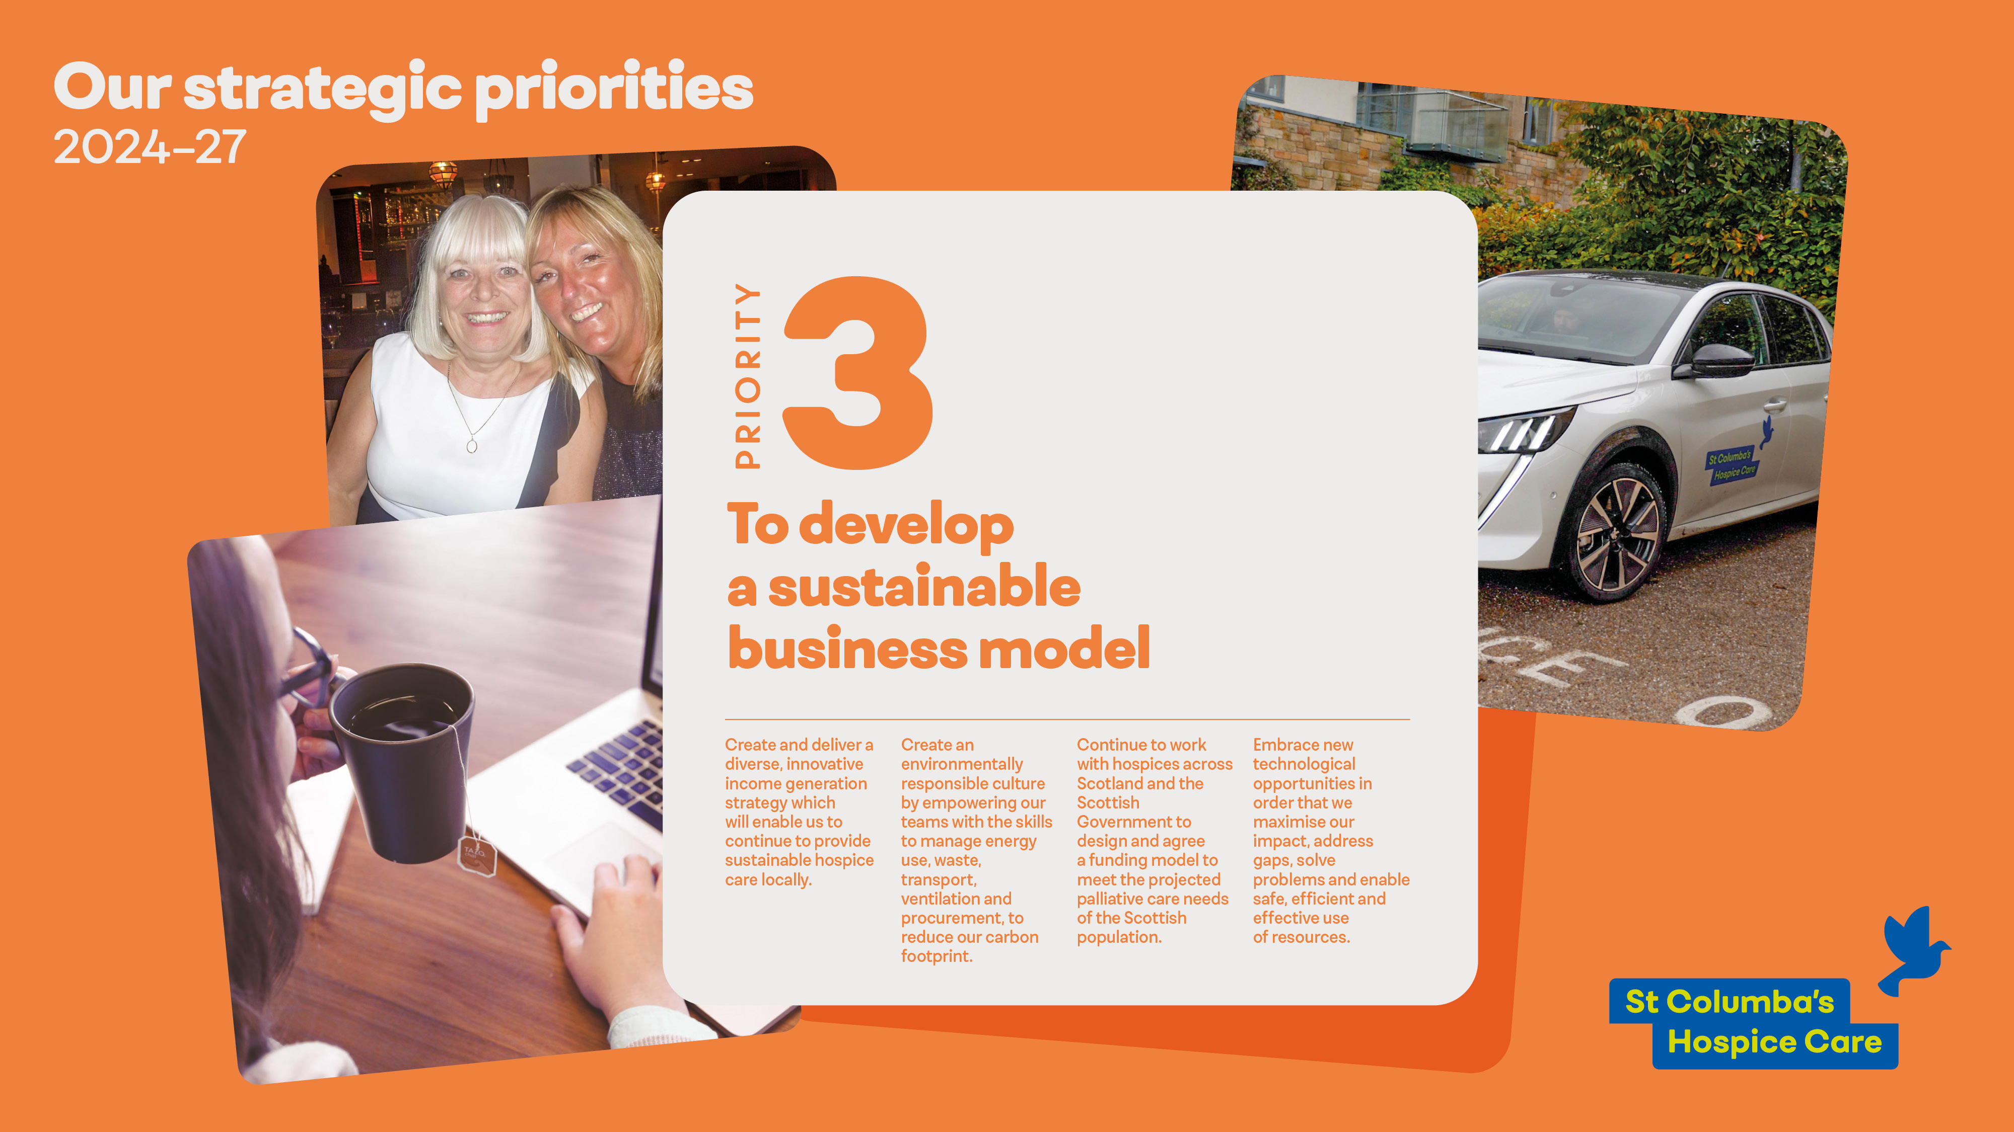

Slide 13
3.1 Create and deliver a diverse, innovative income generation strategy which will enable us to continue to provide sustainable hospice care locally
Over the period of Year 1 of this strategy we have:
Leased and opened a warehouse focusing on the sale of secondhand and reconditioned furniture.
Leased a second warehouse to support the sale of online goods and the distribution of used goods to our charity shops on the East coast.
Appointed a dedicated community fundraiser to work specifically with our East Lothian communities.
Opened a new café and bookshop in North Berwick.
Embedded the customer base of the new Studio 15 hair and nail salon.
Participated in a national legacy campaign with Hospice UK.
Next steps:
Open Manor House Therapies, our new complementary therapy, wellbeing and counselling service, to the public.
To further grow our customer base for our hospice lottery and move the raffle to an online presence.
To grow the sales of online goods, both new and reused.
To explore opportunities for two additional charity shops.
Develop the Hospice’s 50th anniversary campaign and celebrations for 2027.

Slide 14
3.2 Create an environmentally responsible culture by empowering our teams with the knowledge and skills to more efficiently manage our energy use, ventilation, transport, procurement and waste, with the ultimate aim of reducing our carbon footprint
Over the period of Year 1 of this strategy we have:
Upgraded our Combined Heating system to be more energy efficient.
Increased our solar panels from 42 to 267, providing significantly more electricity for the hospice. Excess electricity is now exported to the grid, providing income to the hospice.
Zoned our general meeting spaces to give better heating control.
Upgraded our printers to a more energy efficient version.
Reviewed and reduced our waste across the hospice including participating in hair recycling initiative via Studio 15.
Upgraded the heating systems, and replaced lights with energy efficient bulbs, in our shops,
Next steps:
Replace our patient transport vehicle with a fully electric version.
Working towards zero waste in our catering kitchen.
Consider opportunities for recycling clinical supplies, including medications in line with NHS developments.

Slide 15
3.3 Continue to work with Hospices across Scotland and the Scottish Government to design and agree a funding model to meet the projected palliative care needs of the Scottish population
Over the period of Year 1 of this strategy we have:
Secured a national consensus agreement and appointed a national fundraiser for the Scottish Hospices.
Worked collaboratively with the Scottish Hospices and Hospice UK to develop an agreed model of clinical service provision to support the funding framework discussions.
Secured additional Governmental funding to support the pay award for 2024/25
Secured agreement with Scottish Government to develop a sustainable funding framework for the hospice sector.
Next steps:
Work with Scottish Government to define a funding framework and mechanism for dispensing the funds to the hospices.
Incorporate the national work developing a minimum data set into the funding framework project.
Secure national agreement and mechanisms for specific money to support annual pay awards.

Slide 16
3.4 Embrace new technological opportunities in order that we maximise our impact, address gaps, solve problems and enable safe, efficient and effective use of resources
Over the period of Year 1 of this strategy we have:
Moved all our IT software platforms to a cloud-based version.
Replaced our phone system with an internet-based system.
Improved our cybersecurity across all users.
Recruited a lead for digital services who is developing our digital strategy.
Next steps:
Review our cybersecurity measures to ensure we minimise ongoing risks.
Conduct an assessment of IT needs across the hospice.
Implement the digital ward project which aims to harness technology to enhance care provision.
Consider the role of AI in the Hospice.
Review the Digital team structure and roles to support the emerging strategy.

